Slide 1

Toolkit Doc7 Trim Pieces
April 28, 2010

Slide 2
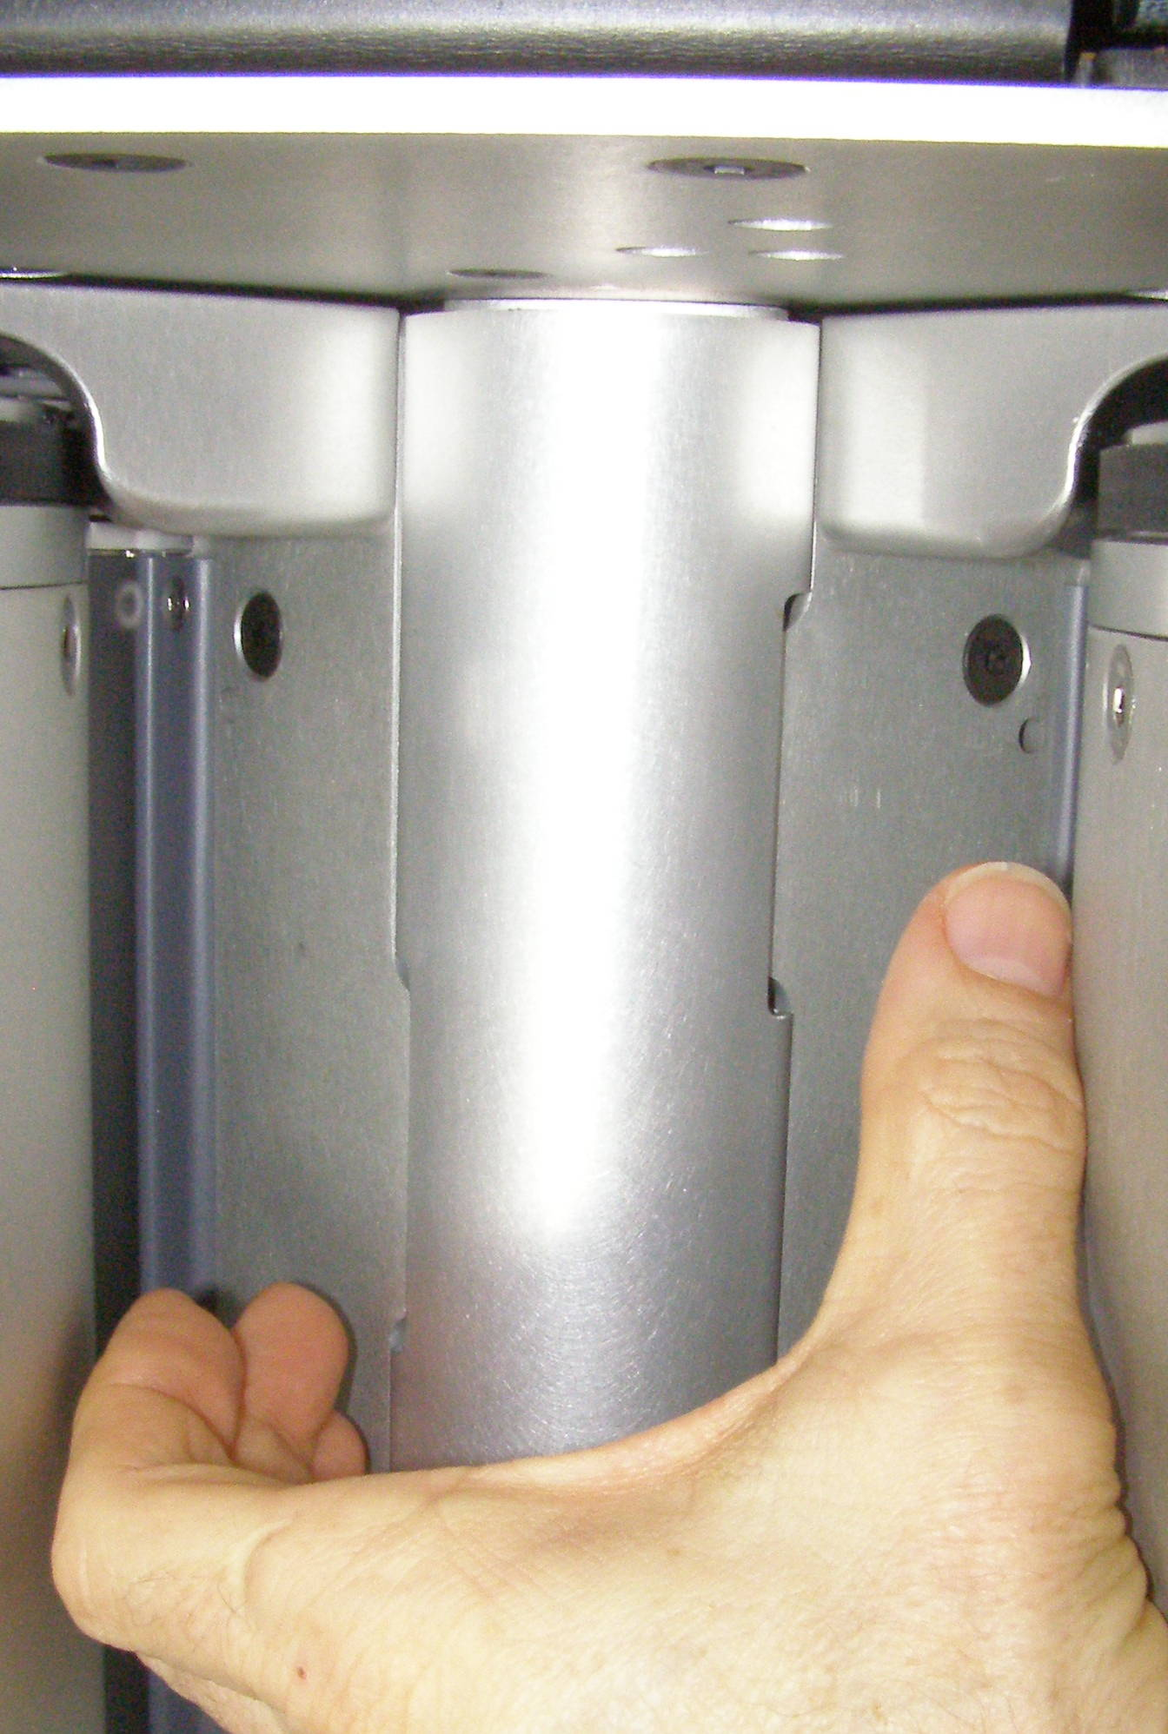
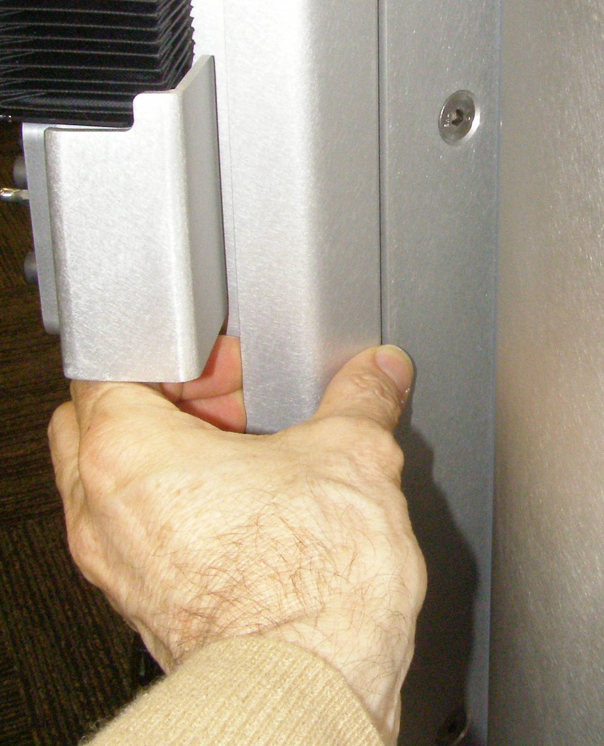
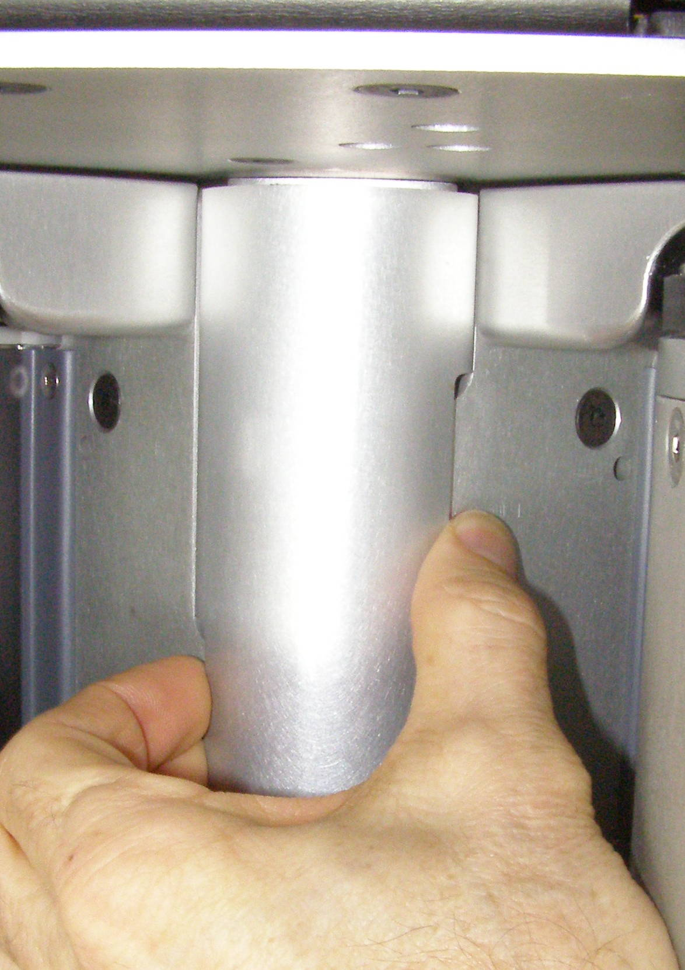
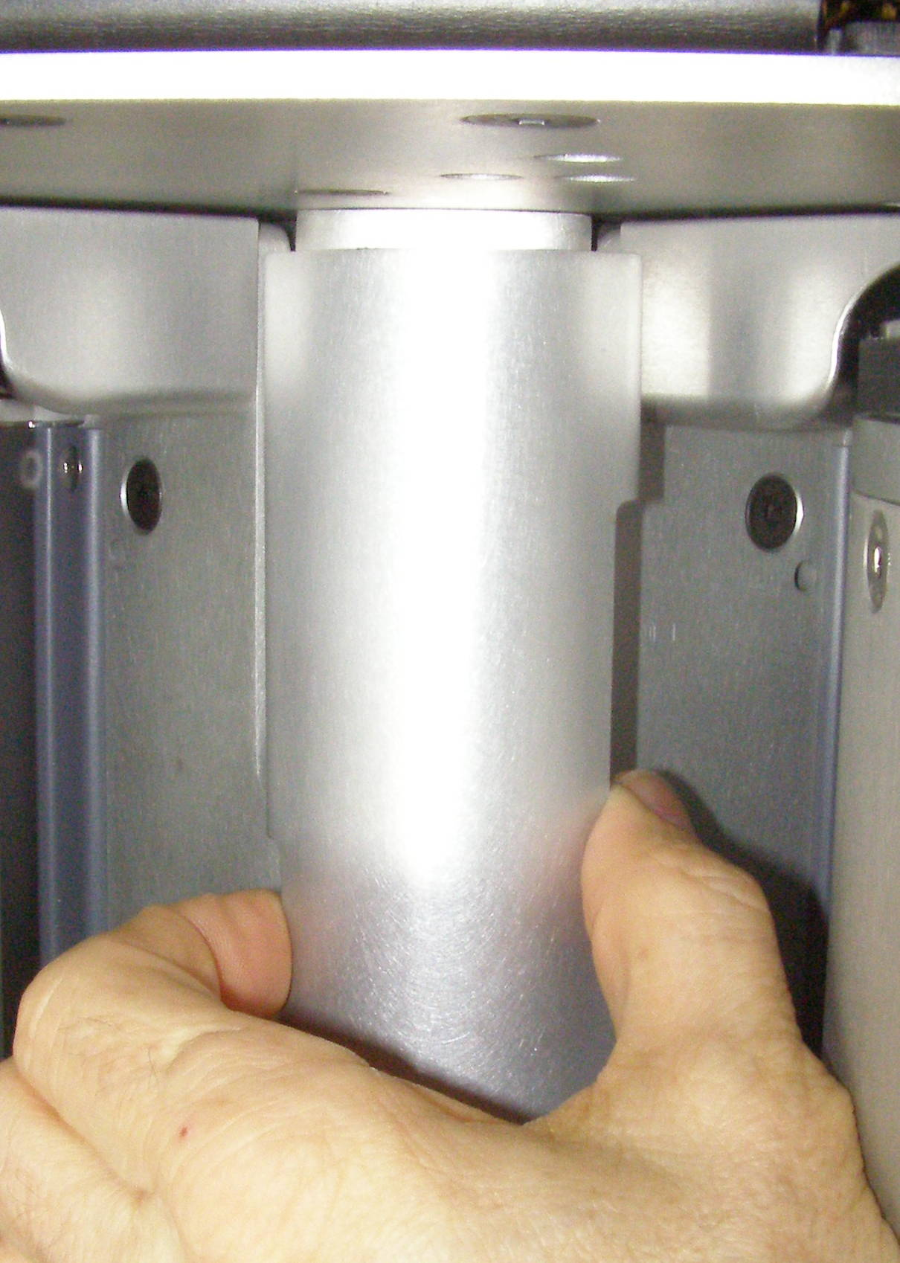
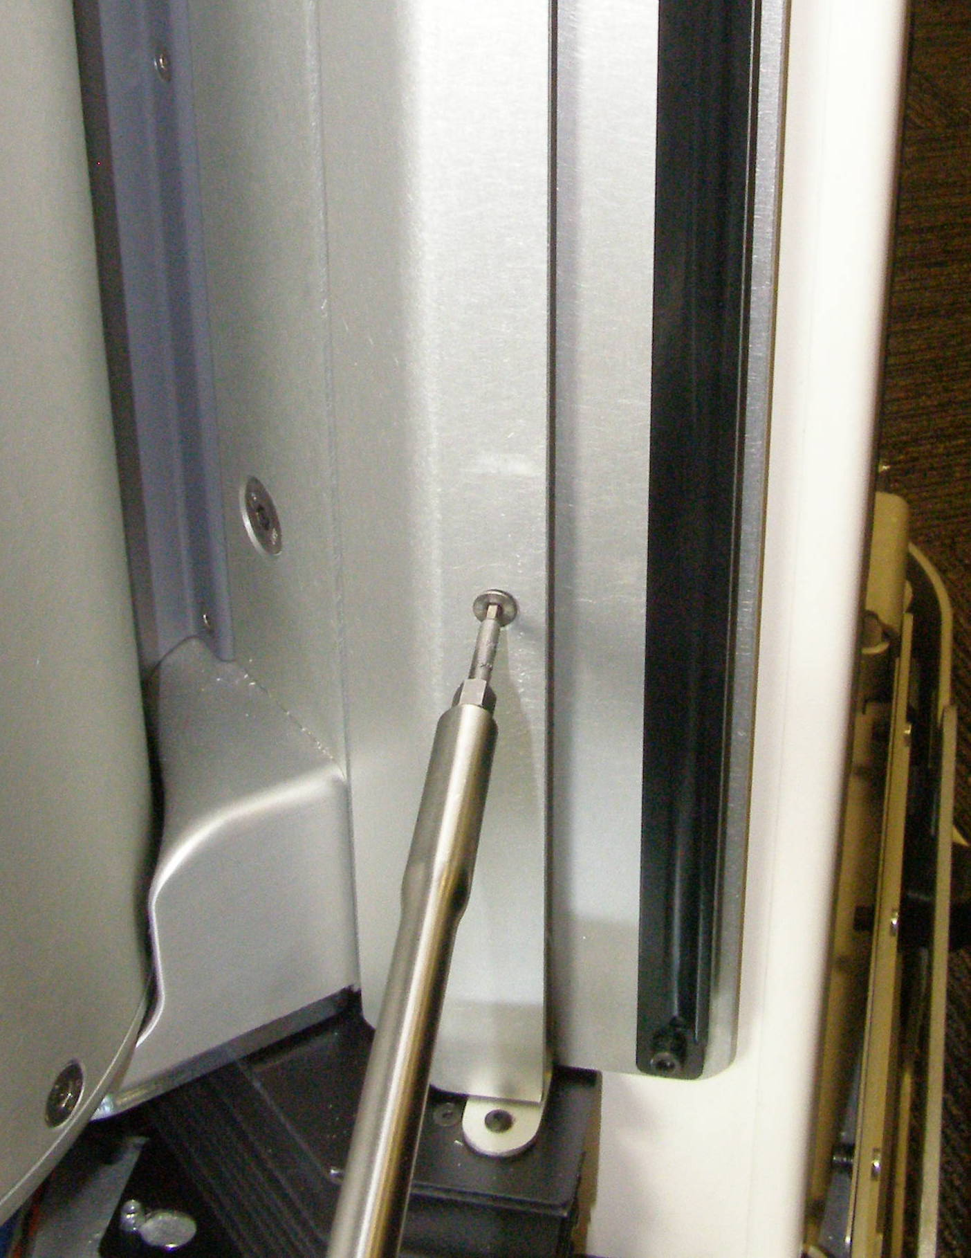
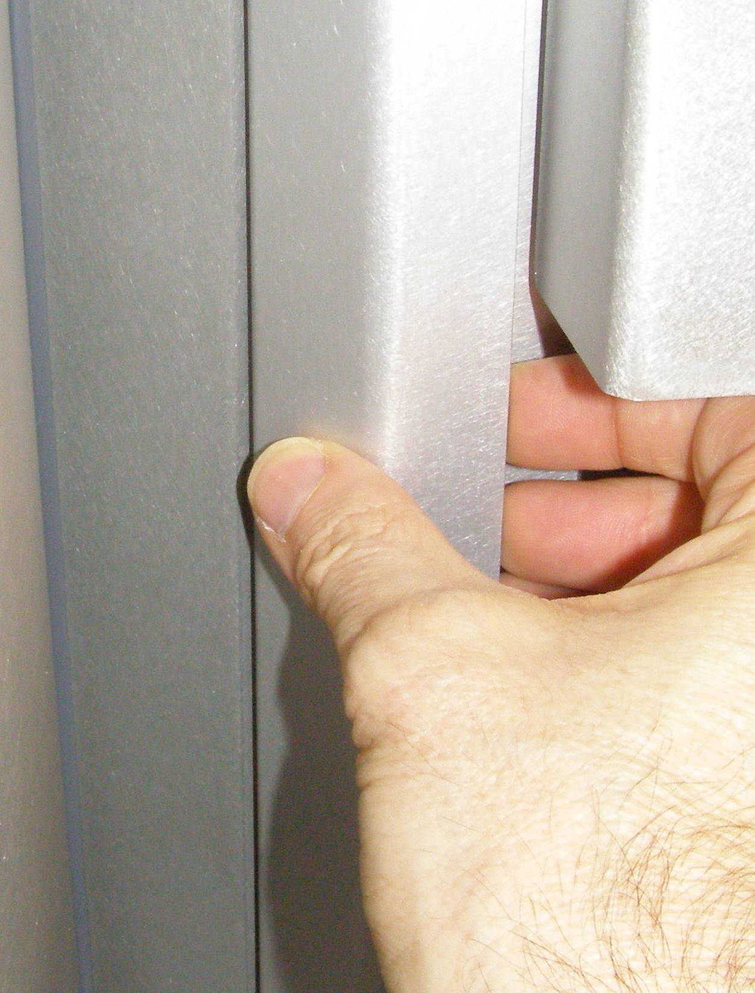
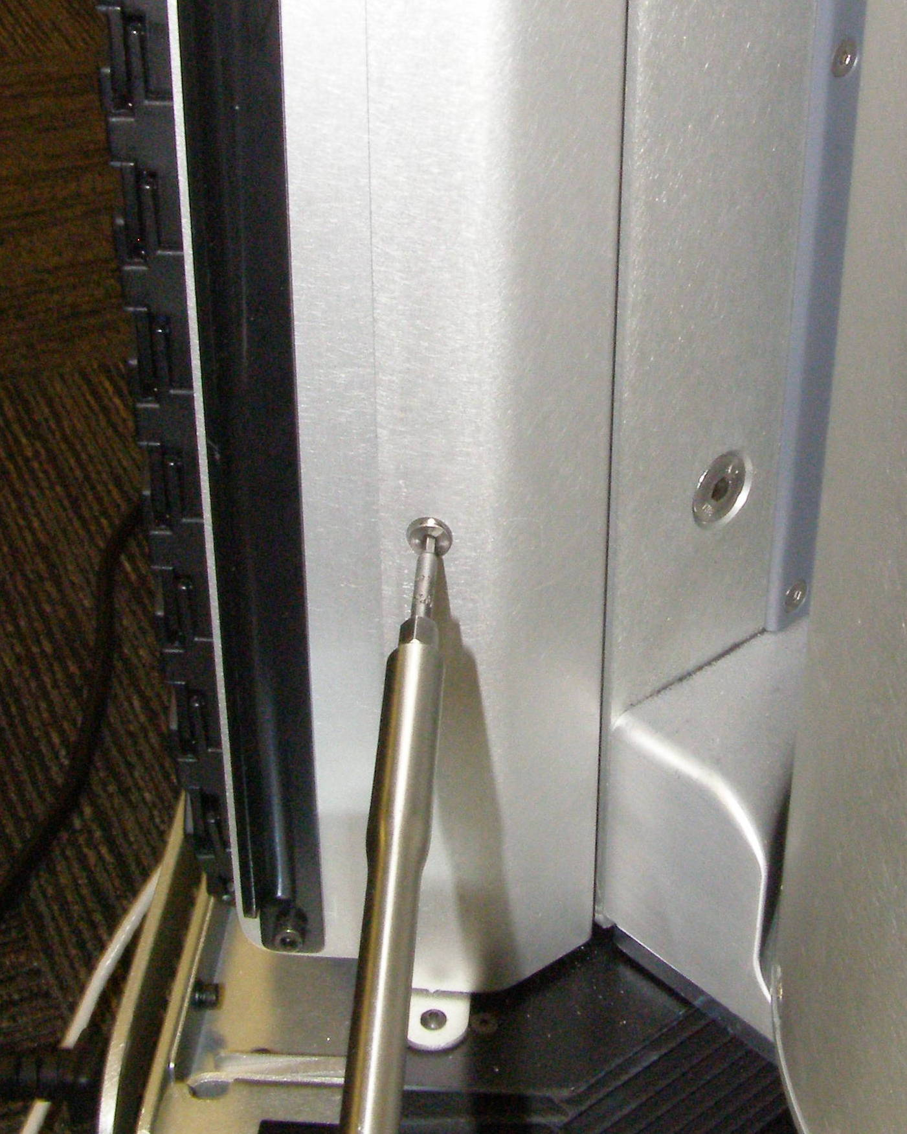
Trim Pieces R/R
Center Trim - 4244
  Grab the top of the Center Trim by the two cutouts near the top. (Fig 1,2)
  Pull straight out until the 3 snaps release, one near the top, middle, and bottom. (Fig 3)
Right Trim – 4262
  Using the 2.5mm bit with the T-handle driver, remove the Flathead screw. (Fig 4)
  Grab the Right Trim just below the Aluminum boss. (Fig 5)
  Pull the Trim straight out until the snap releases, being careful not to let the Trim twist which might bend the snap mount.
Left Trim - 4261
  Using the 2.5mm bit with the T-handle driver, remove the screw. (Fig 6)
  Grab the Right Trim just below the Aluminum boss. (Fig 7)
  Pull the Trim straight out until the snap releases, being careful not to let the Trim twist which might bend the snap mount.
Trim Panel(s), Install
  Reverse the removal procedure.
  Using Loctite 248, install the Flathead screw and torque to 0.68Nm using the Small torque driver.
Fig 1
Fig 1
Fig 2
Fig 5
Fig 6
Fig 3
Fig 7
Fig 4

